Slide 1
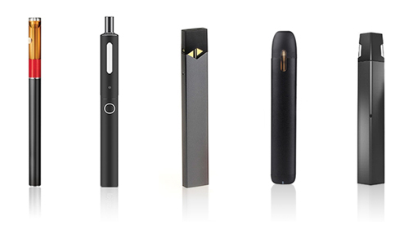
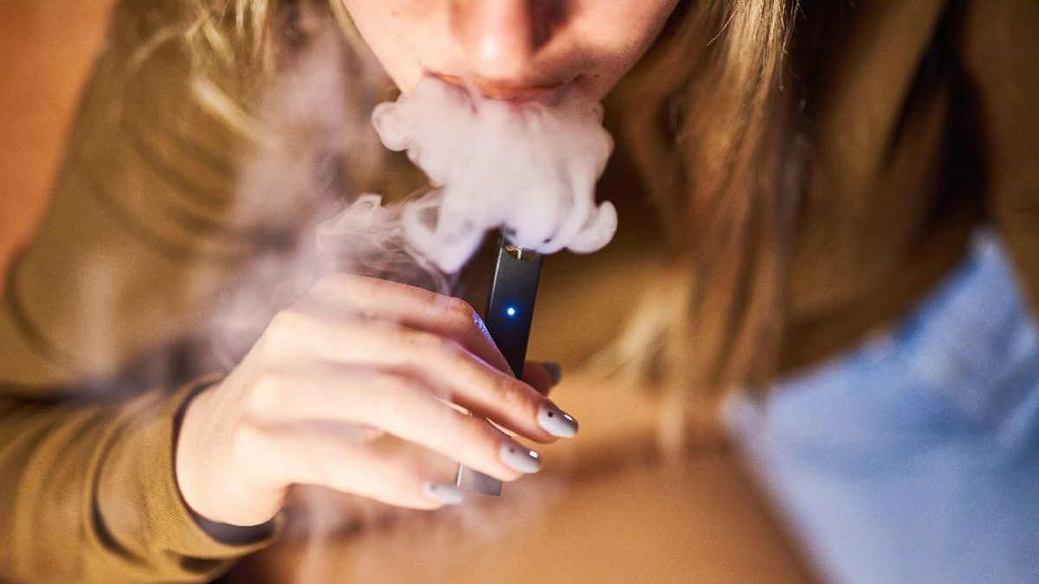
Education to Combat Adolescent E-Cigarette Use Taylor Brown, Kaitlen Kisiloski, Hannah Spring Dean: Dr. Mary Bess Griffith Faculty Advisor: Dr. Marcia Barnes
BACKGROUND/SIGNIFICANCE
PRACTICE IMPLICATIONS
According to the Centers for Disease Control (2019) electronic or e-cigarettes have been the most commonly used tobacco products of middle and high school aged children since 2014. E-cigarette use increased 900% during 2011 – 2014 with only a slight decline noted in 2015-2017. However, current e-cigarette use increased 78% among high school students from 11.7% in 2017 to 20.8% in 2018. In 2018, more than 3.6 million US youth, including 1 in 5 high school students and 1 in 20 middle school students were reported to use e-cigarettes (CDC, 2019). Most e-cigarettes contain nicotine which is highly addictive and can harm brain development. E-cigarettes also have other harmful chemicals besides nicotine. In 2019, more than 2,900 e-cigarette users were injured due to contaminated chemicals within the e-cigarettes (Cobb & Solanki, 2020). The use of e-cigarettes is unsafe for kids, teens, and young adults (CDC, 2019). Considering the potentially harmful effects from e-cigarette use, preventative interventions are needed to deter the use. Currently the only preventative measure is a law preventing the sale of e-cigarettes to those under 21. However, prevention through education should be explored further as a potential deterrent to the intent to use.
In high school students aged 14-18 years, does education on the risks and complications from e-cigarettes impact their intent?
Education is a major skill and intervention nurses provide daily. There is evidence to support that educating youth on the risks of e-cigarette use decreases their intention to ever start smoking (Gaiha et al., 2020). Utilizing the Health Belief Model as a guide for educating youth is important to effectively change perceptions of e-cigarettes and intent to use. According to Reznicek (2019) education was effective in changing perceptions of youth towards e-cigarettes. Nurses play a vital role in health promotion and providing evidence-based education on the use of e-cigarettes is critical to improving the health of adolescents and young adults
.
RESULTS
CONCLUSIONS
Reznicek (2019) conducted pre-post-test study design to assess current vaping practices and measure the effectiveness of an educational campaign about the potential risks of vaping among high school students in grades 9-12 . Education was provided once a week over four consecutive weeks. Pre-survey sample (n=398) and post-survey (n=284) data was obtained. E-cigarette use and vaping was found in 33% of the sample population; 13% higher than the reported 2018 U.S. e-cigarette use. Survey results were grouped into four constructs: knowledge, peer influence, health concern and willingness to use in the future. The constructs of knowledge, t (627) = -3.91, p=0.00, and health concern, t (578) = -2.71, p=0.00, resulted in statistically significant responses. The authors concluded that education increased students’ knowledge about the risk associated with e-cigarette use and vaping. Ongoing research is needed to provide appropriate evidence-based education interventions.
Rhode and colleagues (2018) conducted a study to examine adolescent knowledge and beliefs associated with e-cigarette use. Adolescents (n=69) completed a cross-sectional survey about e-cigarette knowledge, attitudes, and behavior. 47% of the sample reported using e-cigarettes. The majority reported they knew about many of the risks of e-cigarettes but there was no difference between never- and ever-users. The study showed that adolescents who used e-cigarettes were less likely to believe e-cigarettes would cause negative health effects and that they would less likely lead to addiction. Both never-users and ever-users believed that e-cigarettes were not as harmful as combustible cigarettes. Ongoing education is needed.
Gaiha et al. (2020) conducted a pre-post-test study to evaluate a 30-minute educational session based on the Stanford Tobacco Prevention Toolkit on e-cigarette use in a sample (n=2,889) of 6-12 grade students. The school-based education session showed significantly improved (p=<0.001) adolescent knowledge about e-cigarettes, increased perceived harmfulness and addictiveness of e-cigarettes, and reduced intent to try e-cigarettes after the educational session.
O’Conner and colleagues (2019) conducted a systematic review to explore the current state of knowledge on vaping and highlight best or promising practices. The authors recommended education on e-cigarettes, nicotine, addiction and the related dangers would increase the knowledge of teens and help them develop skills to resist media influences and peer pressure to initiate e-cigarette use.
Apperson (2020) conducted a quantitative study and recruited youth aged 11-16 to participate in CDC Know the Risks: A youth guide to e-cigarettes presentation. 23 out of 28 participants completed pretest/posttest survey data. Paired t-tests revealed vaping knowledge scores increased by 7.8 points (out of 100 possible; p = 0.06) and self-efficacy scores increased 0.6 points (with a range of 6 - 30 possible; p = 0.06). Approximately one half of participants (52%) increased vaping knowledge and self-efficacy. Although not statistically significant, results support use of this intervention to address identified clinical problem and improve health outcomes for adolescents and use of e-cigarettes.
School age children have a decreased intention to try electronic cigarettes when educated about the harmfulness and addictiveness of e-cigarette use (Gaiha et al., 2020). This review of the literature revealed that there is a common misconception by youth about the perceived effects and risks associated with e-cigarette use and educational programs result in a decreased intent to use. Nurses can utilize the Health Belief Model to guide educational programs and interventions on perceived threats and alter an individual’s perceptions on the harm of using e-cigarettes, change behaviors, and reduce the intent to use among US adolescents. Continued research should be done to assess which teaching model is most effective in reducing the intent to try e-cigarettes as well as the effectiveness of current educational methods in the future.
METHODS
This review examined whether education influenced the intent to try electronic cigarettes in adolescents aged 14-18 years old. Research terms included e-cigarettes and education, e-cigarettes and education and youth, adolescent vaping and education utilizing the CINAHL and Google Scholar databases through Cumberland University Vise Library . Five articles were found in peer reviewed journals, written in English, and were published in the last five years to be appropriate to answer the PICO question.
This literature review was conducted utilizing the Health Belief Model (HBM). The HBM mainly recognizes how each individual person reacts and interprets a health condition based on health-related behaviors and the individual’s susceptibility to that illness, the severity of the illness, the benefits of taking a preventive action and the barriers to taking that action (LaMorte, 2019). The HBM is appropriate to answer the proposed PICO question by elaborating on whether providing education on e-cigarette use will change behaviors and impact the intent to use.
REFERENCES
Apperson, C. (2020). Enhancing youth vaping knowledge and self-efficacy (Doctoral dissertation, University of Arizona, Tucson, USA). https://repository.arizona.edu/handle/10150/650852
Center for Disease Control. (2019). E-cigarettes: Talk to youth about the risks. https://www.cdc.gov/tobacco/features/back-to-school/e-cigarettes-talk-to-youth-about-risks/index.html
Cobb, N., & Solanki, J. (2020). E-Cigarettes, vaping devices, and acute lung injury. Respiratory Care, 65(5), 713–718. https://doi-org.cumberland.idm.oclc.org/10.4187/respcare.07733
Gaiha, S., Duemler, A., Silverwood, L., Razo, A., Halpern-Felsher, B. & Walley, S. (2020). School-based e-cigarette education in Alabama: Impact on knowledge of e-cigarettes, perceptions and intent to try. Addictive Behaviors, 112, 106519.
Gentzke, A., Creamer, M., Cullen, K., Ambrose, B., Willis, G., Jamal, A. & King, B. (2019). Vital signs: tobacco product use among middle and high school students—United States, 2011–2018. Morbidity and Mortality Weekly, 68(6), 157.
LaMorte, W. (2019). Behavioral Change Models. The Health Belief Model. https://sphweb.bumc.bu.edu/otlt/mphmodules/sb/behavioralchangetheories/behavioralchangetheories2.html
O'Connor, S., Pelletier, H., Bayoumy, D. & Schwartz, R. (2019,). Interventions to prevent harms from vaping . The Ontario Tobacco Research Unit. https://www.otru.org/wp-content/uploads/2019/05/special_vape_interventions.pdf
Reznicek, J. (2019). Adolescent vaping and education: does it make a difference? https://sigma.nursingrepository.org/bitstream/handle/10755/18364/ Reznicek_7_31_9.pdf?sequence=1&isAllowed=y
Rohde, J., Noar, S., Horvitz, C., Lazard, A., Cornacchione Ross, J. & Sutfin, E. (2018). The role of knowledge and risk beliefs in adolescent e-cigarette use: a pilot study. International Journal of Environmental Research and Public Health, 15(4), 830. https://doi:10.3390/ijerph15040830

